Slide 1
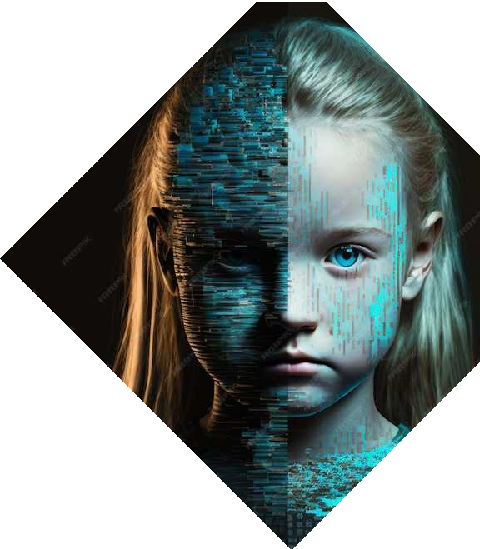
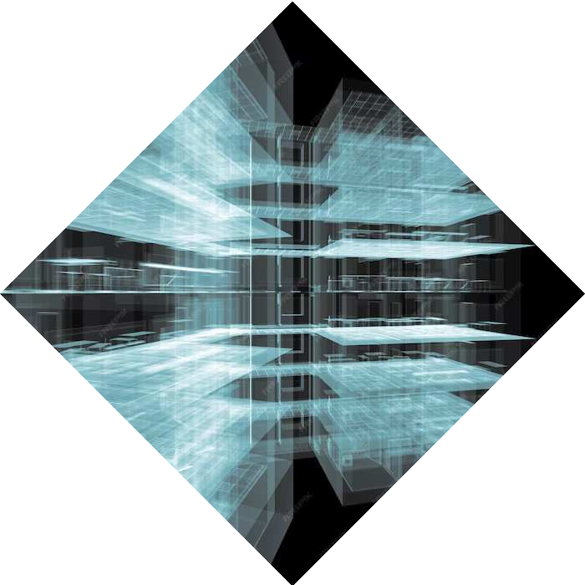
Distributed Pixels: Advancing Image Compression in Parallel Computing
Semester project

Slide 2

Our Team Members
Muhammad Yehya Hayati (K21-3309)
Syed Daniyal Haider Naqvi(K21-3433)
Muhammad Mahad Munir (K21-3388)

Slide 3

Image Compression Fundamentals
Image compression is the process of reducing the size of a digital image file while preserving its visual content. It optimizes storage space, speeds up transmission, and enhances overall system efficiency.

Slide 4
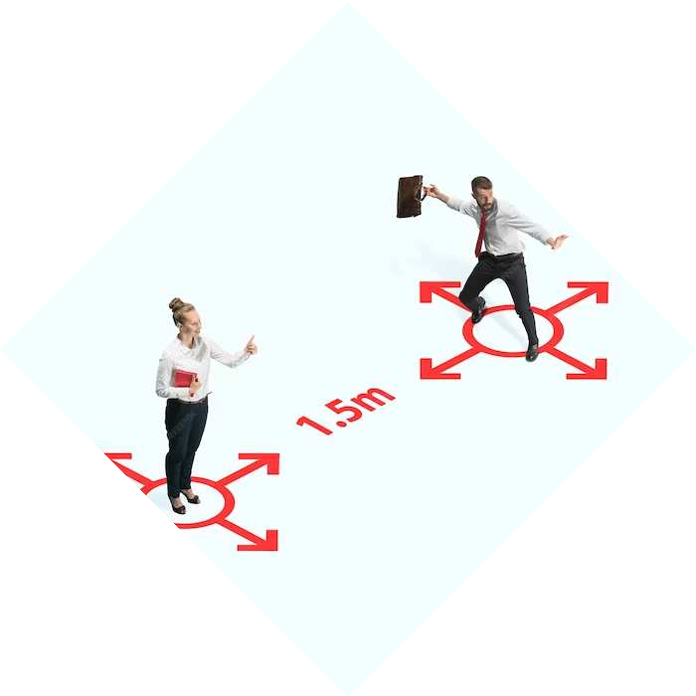
Why we need Parallel Image Processing?
Parallel processing in image compression accelerates the compression and decompression tasks by distributing the workload across multiple processors simultaneously, resulting in faster processing times. This approach optimizes efficiency, enabling swift and resource-effective image compression.

Slide 5
Implementation & Testing
Algorithm:
The main algorithm goes something like this: 1. Open the file to compress
2. Read the header file of the image
3. Count each pixel {3 bytes}
4. Create Minheap
5. Create Huffman Tree
6. Encode Huffman Tree
7. Open new file
8. Write header files to new file
9. Compress data according to Huffman codes 10. Write Compressed Data to new file This is the serial execution of the program. We will make some changes to parallelize this algorithm.
Data Structures Used
Containers {Arrays, Vector}
Priority Queue {Minheap}
Huffman Tree

Slide 6
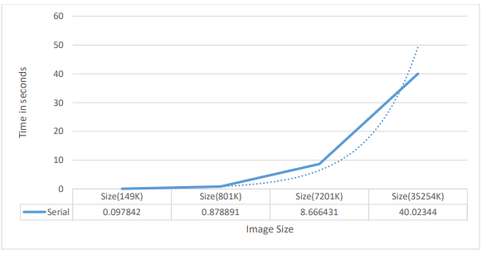
Serial Execution
As you can see, the time taken is exponentially increasing which shows how inefficient this algorithm is

Slide 7
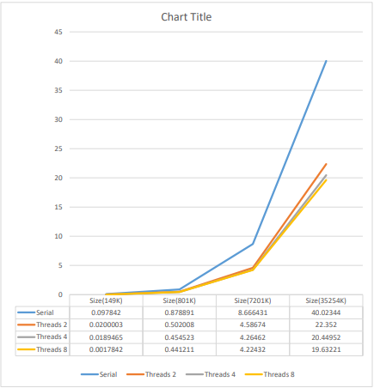
Parallel Execution (OMP)
Significant speed-ups were achieved across various data sizes in our paradigm: 98% for 149K, 50% for 801K, 51% for 7201K, and 51% for 35254K. The overall average speed-up for our paradigm is approximately ~50%. Max Threads Till Crash: 120 "

Slide 8
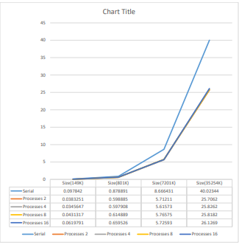
Parallel Execution (MPI)
MPI and OpenMP graphs show similar trends, but efficiency drops near system limits (e.g., 16 processes). OpenMP outperforms MPI due to its Fork-Join Parallelism model versus MPI's message passing system. Max Processes Till Crash : 1024

Slide 9
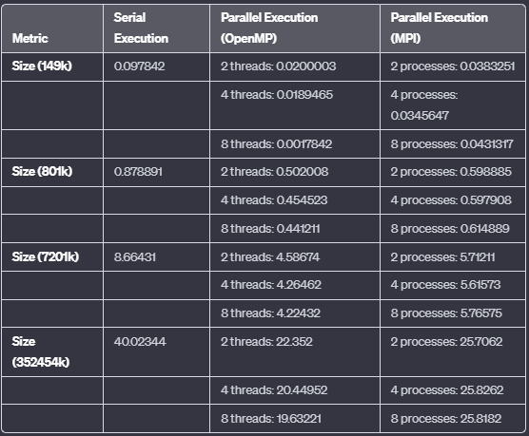
Comparison
OpenMP vs. MPI: OpenMP generally yields faster execution times.
Thread vs. Process Scaling: Both OpenMP and MPI show improved performance with increased threads or processes, yet diminishing returns are observed beyond a certain point.
In conclusion, based on the provided observations, the order of performance, in terms of faster execution times, can be inferred as follows:
1) OpenMP
2) MPI
3) Serial

Slide 10
CONCLUSION
In summary, our application of parallel computing in image compression not only significantly speeds up RGB value compression tasks but also demonstrates the potential for scalable and resource-efficient solutions, paving the way for enhanced performance in various image processing applications.

Slide 11
THANK YOU !

